Slide 1
Lecture 2 Array

Slide 2
Objective
Array Data Structure

Slide 3
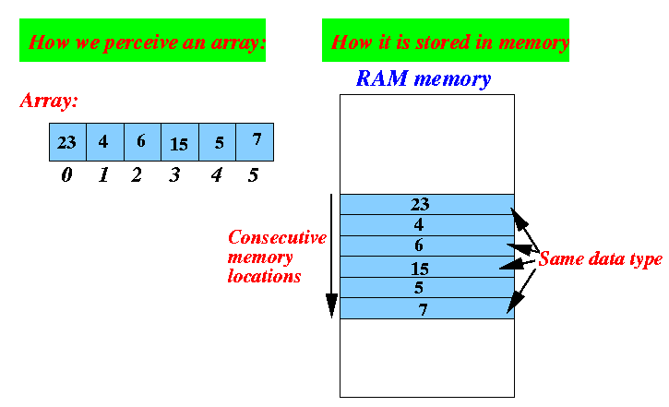
Array
Linear array (One dimensional array) : A list of finite number n of similar data elements, usually 1, 2, 3,…..n.
Let, Array name is A, has 6 elements. Then the values of the elements of A is : 23,4,6,15,5,7 i.e. A[6]=[23,4,6,15,5,7]
Index,k: 0,1,2,3,4,5.
The number k in A[k] is called a subscript and A[k] is called a subscripted variable. So, A[0]=23, A[1]=4 … etc.

Slide 4
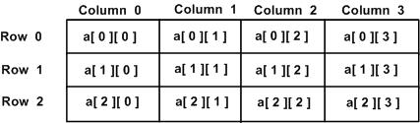
Array (con…)
Two Dimensional Array : Two dimensional array is a collection of similar data elements where each element is referenced by two subscripts.
Such arrays are called matrices in mathematics and tables in business applications.
Example : Array A.
0 1 2 3
0
1
1 | 2 | 3 | 4
5 | 6 | 7 | 8
9 | 10 | 11 | 12
2
Here, A[2,3]=12

Slide 5
Array Data Structure
It can hold multiple values of a single type.
Elements are referenced by the array name and an ordinal index.
Each element is a value
Indexing begins at zero.

Slide 6
Array Operations
Traversing
Visiting every element once of an array and do some work such as printing every element, calculate total element etc.
Say, A[3]={10,15,20}
For printing this array we need to visit this array element once.
For Adding all element or counting total element of this array we also need to visit this array element once.

Slide 7
Array Operations
Traversing Algorithm
1. [Initialize counter] Set k: =LB.
2. Repeat steps 3 and 4 while k <=UB.
3. [Visit Element] Apply PROCESS to LA [k].
4. [Increase Counter] Set k: =k + 1. [End of step 2 loop]
5. Exit.

Slide 8
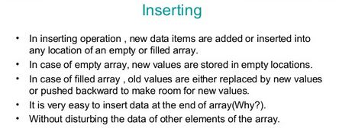
Array Operations

Slide 9
Array Operations
Insertion Algorithm
(Inserting into Linear Array) INSERT (LA, N, K, ITEM) 1. [Initialize counter] Set J: = N. 2. Repeat Steps 3 and 4 while j >= k; 3. [Move jth element downward.] Set LA [J + 1]: =LA [J]. 4. [Decrease counter] Set J: = J-1 [End of step 2 loop] 5. [Insert element] Set LA [K]:=ITEM. 6. [Reset N] Set N:=N+1 7. EXIT.

Slide 10
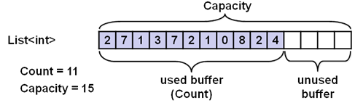
Array Operations
Suppose an array a[15]={2,7,1,3,7,2,1,0,8,2,4}
Now, If we need to insert data in 2nd position then?
Need to insert new value in proper position and then array will be
A[15]={2,New Value,7,1,3,7,2,1,0,8,2,4}
Easy way to insert
New Element here

Slide 11
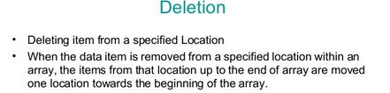
Array Operations
Let array A={1,2,3,4,5,6}
Output will be:
Want to delete 3
OR
value of third position
1 | 2 | 3 | 4 | 5 | 6
1 | 2 | 4 | 5 | 6

Slide 12
Array Operations
Deletion Algorithm
(Deletion from a Linear Array) DELETE (LA, N, K, ITEM) Here LA is a Linear Array with N elements and K is the positive integer such that K<=N. This algorithm deletes the Kth element from LA. 1. Set ITEM: = LA [k]. 2. Repeat for J = K to N – 1. [Move J + 1st element upward] Set LA [J]: = LA [J +1]. [End of loop] 3. [Reset the number N of elements in LA] Set N: = N-1 4. EXIT

Slide 13
Array Operations
Searching : Linear search
DATA is a linear array with n elements. The most intuitive way to search for a given ITEM in DATA is to compare ITEM with each element of DATA one by one. That is first we test whether DATA[1 ]=ITEM, and then we test whether DATA[2 ]=ITEM, and so on. This method, which traverses DATA sequentially to locate ITEM, is called linear search or sequential search.

Slide 14
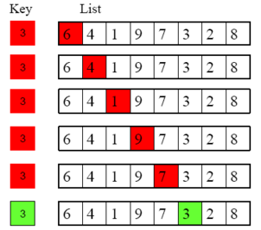
Array Operations
Suppose an array DATA={6,4,1,9,7,3,2,8}
We want to find where 3 is situated, Or whether 3 is present or not? Then, Check Data[0] with 3. If not match then check with DATA[1] and so on.

Slide 15
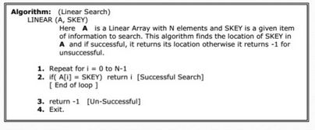
Array Operations

Slide 16
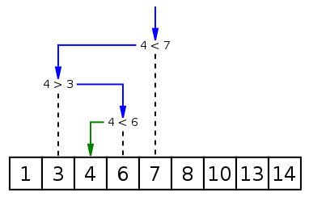
Array Operations
Searching: Binary Search
If we place our items in an array and sort them in either ascending or descending order on the key first, then we can obtain much better performance with an algorithm called binary search. In binary search, we first compare the key with the item in the middle position of the array. If there's a match, we can return immediately. If the key is less than the middle key, then the item sought must lie in the lower half of the array; if it's greater then the item sought must lie in the upper half of the array. So we repeat the procedure on the lower (or upper) half of the array.

Slide 17
Array Operations
Given an array A of n elements with values or records A₀ ... A_{n−1}, sorted such that A₀ ≤ ... ≤ A_{n−1}, and target value T, the following subroutine uses binary search to find the index of T in A.
Set L to 0 and R to n − 1.
If L > R, the search terminates as unsuccessful.
Set m (the position of the middle element) to the floor of (L + R) / 2.
If A_{m} < T, set L to m + 1 and go to step 2.
If A_{m} > T, set R to m – 1 and go to step 2.
Now A_{m} = T, the search is done; return m.

Slide 18
Question?

